Slide 1
Project of Computer Networks： Implementation of a DNS Relay

Slide 2
Outline
Basic requirements
What is DNS
How to use Wireshark
How to make socket programming

Slide 3
DNS Relay
Receiving DNS queries from DNS client (Resolver) and forward them to a given DNS server
Receiving DNS responses from DNS server and forward them to the Resolver
Query
Query
DNS Relay
DNS Server
Resolver
Response
Response

Slide 4
3 Cases
Checking local database (eg. dnsrelay.txt) first
Case 1: for IP address 0.0.0.0, sending back “no such name” (reply code =0011)
Case 2: for domain name included in the database, sending back corresponding IP address
Case 3: for domain name not included in the database, forward query to local DNS server

Slide 5
Environment
OS:
Windows or Linux
Programming language:
C, C++, Java,Python,…
Working in a group
3 persons
1 source program and 1 report

Slide 6
Getting started Understanding DNS
Domain Name System
A distributed database providing mapping between Domain name and IP address
Implemented in hierarchy of many name servers
An application protocol
Used by hosts and name servers to communicate to resolve names
Mostly using UDP in transport layer

Slide 7
Domain Namespace – the hierarchical structure
Unnamed root
Top level domains
com
edu
gov
int
mil
net
org
ae
…
cn
…
zw
2nd level domains
mit
edu
cs
bupt
xx
xx.cs.mit.edu
cs.bupt.edu.cn
cs
Generic domains
Country domains

Slide 8
Name Servers
Name servers are the repositories of information that make up the domain database.
Answering queries about name information

Slide 9
DNS Clients: Resolvers
The interface between the user program and the domain name servers
A resolver receives a request from a user program (e.g., HTTP, mail programs, TELNET, FTP，Ping)
Asks questions to the DNS system on behalf of the application
And returns the desired information
Notes:
gethostbyname

Slide 10
eg. DNS working together with the HTTP application
Browser
User types in or click on a URL
Browser extracts the site name
Resolver
Browser calls resolver to learn IP address
Query the local DNS server
Contacts the Web server
Gets a reply
Web server

Slide 11
Name information: Resource Records
Each domain in the DNS has one or more Resource Records (RRs), which are fields that contain information about that domain
Each RR has the following information
Owner: the domain name where the RR is found
Type: specifies the type of the resource in this RR
A – Host Address
MX – Mail Exchanger
…
Class: specifies the protocol family to use
IN – the Internet system
TTL: specifies the Time To Live (in unit of second) of the cached RRs
RDATA: the resource data

Slide 12
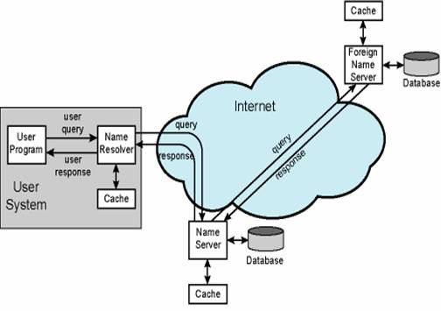
Caching mechanisms
Caching at the name servers
Caching at the hosts

Slide 13
Protocol details: Message Format (from RFC 1035)
0
15
16
Flags
31
Header
Question Section
Answer Section
Authority Section
Additional Section
ID | QR | OPCODE |  |  |  |  | Z | Rcode
Question count | Answer count
Authority count | Additional count
AA TC RD RA
Fixed length
(variable number of questions)
(variable number of Resource Recordss)
Variable length
(variable number of Resource Recordss)
13
(variable number of Resource Recordss)

Slide 14
DNS Message Header Structure(1)
ID: 16-bit field used to correlate queries and responses.
QR: 1-bit field that identifies the message as a query (0) or response (1).
OPCODE: 4-bit field that describes the type of query:
0: Standard query (name to address). 1: Inverse query (address to name). 2: Server status request.
AA: Authoritative Answer. 1-bit field. When set to 1, identifies this response is made by an authoritative name server.
TC: Truncation. 1-bit field. When set to 1, indicates the message has been truncated due to length greater than that permitted.
RD: Recursion Desired. 1-bit field. Set to 1 by the resolver to request recursive service by the name server.
RA: Recursion Available. 1-bit field. Set to 1 by name server to indicate recursive query support is available.
Z: 3-bit field. Reserved for future use. Must be set to 0.

Slide 15
DNS Message Header Structure(2)
RCODE: Response Code. 4-bit field that is set by the name server to identify the status of the query:
0: No error condition. 1: Unable to interpret query due to format error. 2: Unable to process due to server failure. 3: Name in query does not exist. 4: Type of query not supported. 5:Query refused for policy reasons.
QDCOUNT(Question count): 16-bit field that defines the number of entries in the question section.
ANCOUNT(Answer count): 16-bit field that defines the number of resource records in the answer section.
NSCOUNT(Authority count): 16-bit field that defines the number of name server resource records in the authority section.
ARCOUNT(Additional count): 16-bit field that defines the number of resource records in the additional records section.

Slide 16
Question Section Format
0
15
16
31
QEURY DOMAIN NAME (variable number of domain names)
QUERY TYPE | QUERY CLASS
QUERY TYPE: 16-bit field used to specify the type of the query
A(1) – Host address
MX(15) – Mail exchanger for the domain
…
QUERY CLASS: 16-bit field used to specify the class of the query
IN(1) – Internet system
…

Slide 17
Resource Record Format (1)
0
15
16
31
DOMAIN NAME
TYPE | CLASS
TTL
RESOURCE DATA
RESOURCE DATA LENGTH

Slide 18
Resource Record Format (2) – type field
SOA
Start Of Authority--identifies the domain or zone and sets a number of parameters
NS
Maps a domain name to the name of a computer that is authoritative for the domain
A
Maps the name of a system to its address. If a system (e.g., a router) has several addresses, then there will be a separate record for each.
AAAA
Maps the name of a system to its IPv6 address. If a system (e.g., a router) has several addresses, then there will be a separate record for each.
CNAME
Maps an alias name to the true, canonical name
MX
Mail Exchanger. Identifies the systems that relay mail into the organization

Slide 19
Resource Record Format (3) – type field
TXT
Provides a way to add text comments to the database. For example, a txt record could map abc.com to the company's name, address, and telephone number
WKS
Well Known Services. Can list the application services available at the host. Used sparingly, if at all
HINFO
Host Information, such as computer type and model. Rarely used
PTR
Maps an IP address to a system name. Used in address-to-name files.

Slide 20
Example of Resource Records(1)
Type=A
Name= Domain name , Value= IP Address
ns.bupt.edu.cn 86400 IN A 202.112.10.37
Type=NS
Name= Domain, eg. bupt.edu.cn
value= Domain name of Authoritative Name Server
bupt.edu.cn 86400 IN NS ns.bupt.edu.cn

Slide 21
Example of Resource Records (2)
Type=CNAME
Name= canonical name
Value= the name
dns.bupt.edu.cn 86400 IN CNAME ns.bupt.edu.cn
Type=MX
Name= Domain name
Value= canonical name of mail server
bupt.edu.cn 86400 IN MX mail.bupt.edu.cn

Slide 22
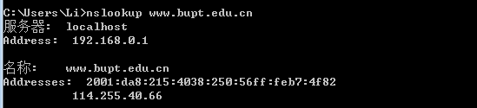
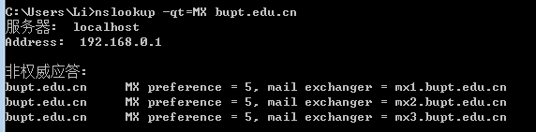
DNS tools: nslookup
Query type=A
Query type=MX

Slide 23
Using wireshark to understand the communications
Wireshark: A network protocol analyzer (packet sniffer)
Able to capture packets transferred on the network and display packet fields and their meanings
Used for network troubleshooting, analysis, software and communications protocol development, and education.

Slide 24
Download Wireshark
Official website
http://www.wireshark.org/
Download page
http://www.wireshark.org/download.html

Slide 25
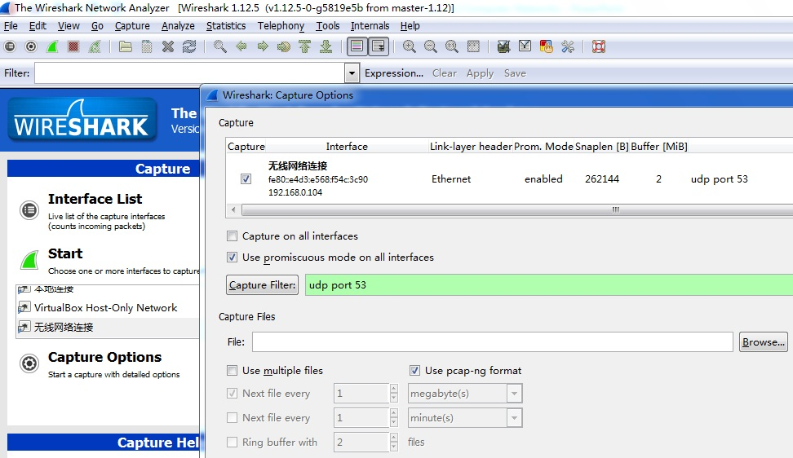
Starting wireshark in windows
以管理员身份运行
Select Interface, set Capture Filter, then press Start
Notes:
Vista和Win7环境下，需要以管理员身份运行wireshark,
或者在command环境(管理员身份运行)下，运行 net start NPF

Slide 26
How to initiate the communications?
DNS
Start Wireshark
You can access a website in your browser
Or you can use nslookup in command line

Slide 27
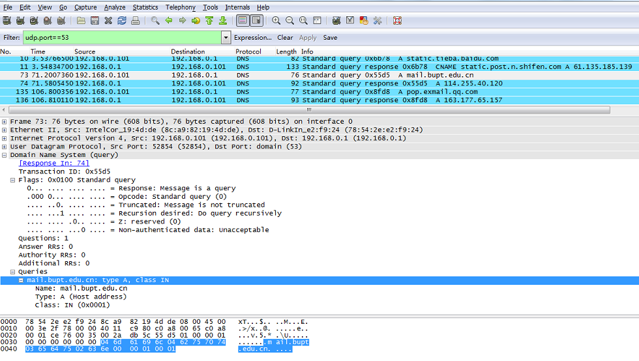
display filter
A DNS query message
Notes:
dns

Slide 28
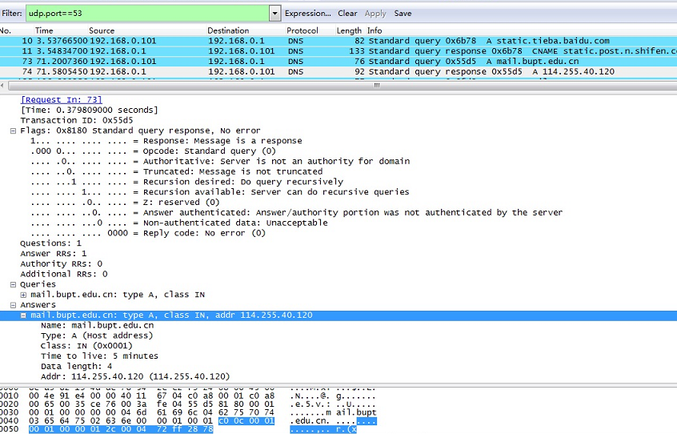
A DNS response message

Slide 29
Using Socket programming
Socket: an extension to OS’s I/O system, enabling communication between processes and machines
A interface (a “door”) into which application process can both send and receive messages to/from another (remote or local) application process

Slide 30
Socket programming using UDP
Socket: a door between application process and end-end transport protocol (UDP or TCP)
UDP service: unreliable transfer of datagram from one process to another
controlled by
application
developer
controlled by
application
developer
process
process
socket
socket
controlled by
operating
system
UDP with
buffers,
variables
UDP with
buffers,
variables
controlled by
operating
system
Internet
Client
Server

Slide 31
Overview of UDP-based sockets API
UDP Client
UDP Server
socket()
socket()
bind()
data
sendto()
recvfrom()
data
recvfrom()
sendto()
close()

Slide 32
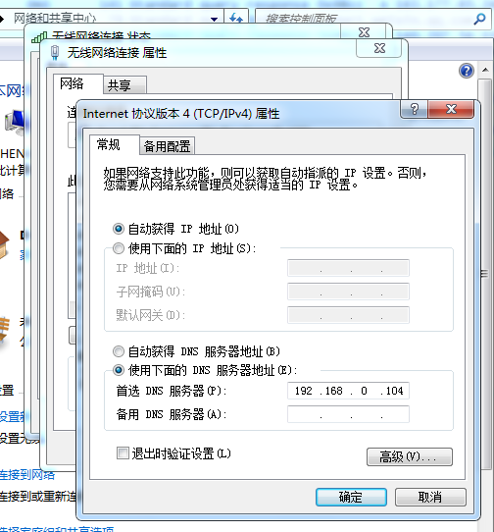
Running the program (1)
1. Get the IP address of your DNS server (eg. 202.106.0.20 ) and your IP address (eg. 192.168.0.104 )
c:> ipconfig /all
2. configure your DNS server as your IP address (eg. 192.168.0.104 or 127.0.0.1)
Notes:
ipconfig

Slide 33
Running the program (2)
3. Running your program, setting local DNS server as 202.106.0.20
4. using ,nslookup, ping，web browser… to test your program

Slide 34
Example implementation
Command
dnsrelay [-d | -dd] [dns-server-ipaddr] [filename]

Slide 35
About project reports
Following contents shall be included:
Requirement analysis
Decomposition of functional modules
Overall flow chart
Flow charts in each module
Testing and results
Summary of works and future improvement

Slide 36
Deadline
Evaluation
8:30-16:20, July 16(calss17/18)
17(calss19/20)
18 (class21/22)
Report
Packing and email to gaozc@bupt.edu.cn before 0 o’clock July 12
Named as studentID1Name-ID2Name-ID3Name.pdf or doc

